Slide 1
Project 3: Ticket Printer

Slide 2
Project 3: Ticket Printer
Write a program to produce a set of tickets for a specific performance at a specific venue.
You can modify the Ticket class from Project 1 for use in this project.
OK to use posted solution.

Slide 3
Class Venue
Write a definition for class Venue.
A Venue object corresponds to a physical site for a performance.
Attributes of a Venue are:
Name
Address (Described later)
A collection of Seats
Details on next slide
Capacity (total number of seats)
Capacity is computed from the seats collection.

Slide 4
Class Venue
Let a Venue have a collection of Seat_Row objects.
Maximum of 1000 rows.
Each Seat_Row object has
A row name
Number of seats.
A collection of seats.
Seats in each row are numbered consecutively starting with 1.
Maximum of 1000 seats in a row.

Slide 5
Class Address
Define a class to represent Addresses
Attributes of an Address
Street address
City
State – 2 characters
Zip code – 5 digits
Street address, City, and State should be C++ strings.
Provide accessor functions to get (but not set) the values of all attributes.

Slide 6
Class Venue
Design diagram for Venue
Classroom discussion.

Slide 7
Class Performance
Define a class to represent performances
Attributes of a Performance
Show Name (C++ string)
Venue
Date – Day, Month, Year (integers)
Time – Hour, Minute (integers)
Date and Time are the same as in Project 1

Slide 8
Class Performance
Design diagram for Performance
Classroom discussion.

Slide 9
Class Ticket
Attributes of a Ticket:
Performance
Includes Venue and date/time
Seat
Sold (boolean)

Slide 10
Class Ticket_Book
A Ticket_Book object holds tickets for all seats of a specific Performance.
Display method outputs a complete set of tickets.
For this project, output to the screen.

Slide 11
Class Ticket_Book
Design diagram for Ticket_Book
Classroom discussion.

Slide 12
Program Ticket_Printer
Your main() function should produce a Ticket_Book for a performance of “Billy Elliot” at The Little Theater on April 2, 2016 at 8:00 PM.
The Little Theater is located at 19 Foster Street, Littleton, MA, 01460.
The Little Theater has 3 rows, with names A through C.
Each row has 4 seats.

Slide 13
Program Ticket_Printer
Use the main() function on the following slide.
Create a Venue object.
Create a Performance object.
Create a Ticket_Book object.
Use the Ticket_Book object to display the tickets on the screen.
There is no user input.
All information must be built in.
A more realistic program would get the needed information from a file.

Slide 14
main()
int main()
{
cout << "This is program Ticket_Printer\n\n\n";
Venue* venue = Create_Venue();
Performance* performance = Create_Performance(venue);
Ticket_Book* ticket_book = new Ticket_Book(performance);
ticket_book->Display();
cin.get();
return 0;
}

Slide 15
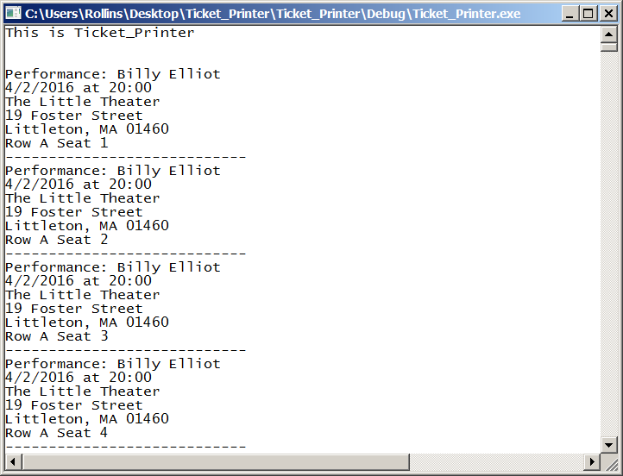
Program Output

Slide 16
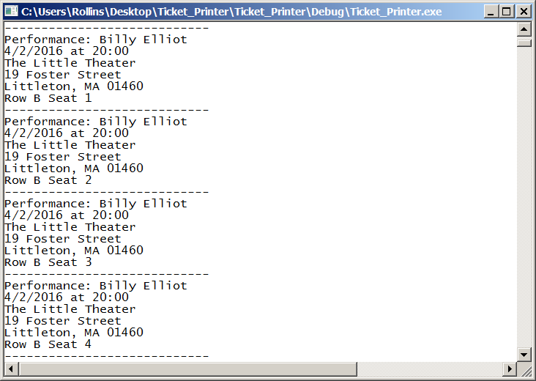
Program Output

Slide 17

Program Output

Slide 18
Development Environment
You may develop your program on any system you like.
But you should test the finished program on Circe.
The same source files should compile and run on either Windows or Linux.

Slide 19
Ground Rules
You may work with one other person.
OK to work alone if you prefer.
If you do work as a pair
Both members are expected to contribute.
Submit a single program.
Both members should understand the program in detail.
Do not share your code with other students.
Before or after submitting the project.
OK to discuss the project.
Do not copy any other student’s work.
Don’t look at anyone else’s program.
Don’t let anyone look at your program.

Slide 20
Ground Rules
Except for code posted on the class web site
Do not copy code from the Internet
or any other source.
Write your own code.

Slide 21
Submission
Project is due by 11:59 PM, Thursday, Feb. 11.
Deliverables:
Source code only.
Zip the files for submission.
Please put your source files into a folder
Use the Windows “Send to Compressed Folder” command
Do not submit any other form of zipped folder
If you have trouble zipping the files, submit the separate files.
If you work with another student, include both names in the Canvas submission comments.
Other student should submit just a Blackboard comment including both names (if possible)
End of Presentation

